Slide 1

Department of Information Technology
NBA Accredited A.P. Shah Institute of Technology G.B.Road,Kasarvadavli, Thane(W), Mumbai-400615 UNIVERSITY OF MUMBAI Academic Year 2020-2021

Slide 2
A Project Report on Campus Walk-through Using VR
Submitted in partial fulfillment of the degree of Bachelor of Engineering(Sem-8)
in INFORMATION TECHNOLOGY By Mandar Kumbhar (17104017)
Sahil Naik (17104054) Rutvik Lathiya (17104050) Under the Guidance of Prof. Kaushiki Upadhyaya
Prof. Nahid Shaikh

Slide 3
1.Project Conception and Initiation

Slide 4
1.1 Abstract
Virtual campus acts as an interactive walk-through application that is based on Virtual Reality. This paper explains all phases of building the virtual campus starting from requirement gathering to building the final application, which includes other phases such as modeling, texture mapping, and scripting. This Virtual Reality application can be used by the institute to introduce students, newcomers, to the campus with a Virtual Model of the college and make them familiar with the facilities available. It will provide a real-life walkthrough of the campus while being stationary with VR ready devices. It uses Blender for preparing 3d models, unity 3d to prepare the structural model, and adding user interaction to an application through scripts and Google VR plugins.

Slide 5
1.2 Objectives
To provide an interactive walk-through of college.
To provide users with an actual feel and experience as there are visiting the campus in real life.
Displaying correct information about facilities and providing a navigation system to the user for efficient virtual roaming.
Using teleporting technique for virtual roaming other than controllers to avoid motion sickness.

Slide 6
1.3 Literature Review
Gilson Giraldi et al. (2016), This paper has represented the basics of virtual reality and describes its application, how to interact with 3D computer-generated worlds. Also discussed virtual reality applied to scientific, visualization, medicine, and engineering and main perspectives of virtual reality and presents various virtual reality devices like Head mounted Displays, VR glasses, Crystal Eyes, Data glove, Cyber puck, explain various VR system like Cave immerse Desk, Infinity wall, Collaboration VR system.
Xue-qin Chang et al. (2016), This paper describes web 3d technology as a system based on virtual reality, which can be implemented by the method of system engineering design. This system is a simulation of real-life campus of college where students can attend class virtually, do activities and make friends. The teacher can take lectures, can review the work of students and also can take an online test.

Slide 7
Jorge Martin Gutierrez et al. (2016), This Paper explains the various applications of virtual reality. It has explained how virtual reality can be implemented in various sectors like tourism, medicine, industry, video games, or education. As in educational institutions, virtual technology can benefit to teach content that is impossible to visualize in a physical classroom. It has also explained how these virtual technologies will break the boundaries of visualizing and implementation of formal education.
Chris Christou (2015), This paper describes the key features of VR that allows multi-sensory interaction within the visualized space and explain the various technologies that can be used to visualize and provide interaction in the Virtual world.

Slide 8
1.4 Problem Definition
To create a Virtual Reality application for the institute to introduce students newcomers to the institute with a Virtual Model of the college and make them familiar with the facilities available.
To provide a real life walk-through of the campus while being stationary with VR ready devices.

Slide 9
1.5 Scope
If a student wishes to visit college to see the facilities during Pandemic, they would be unable to do so. They won't be able to experience anything on their own as a result of this. All of this will be possible with our system because the student will be able to take a virtual tour of the college.

Slide 10
1.6 Technology stack
Software Requirements:
Unity 3D
Blender :-
• Texture Mapping- UV Mapping
• Rendering Engine- Eevee and Cycles
Hardware Requirements:
VR Headset
VR Controllers

Slide 11
1.7 Benefits for environment & Society
This Application can be used anywhere and anytime without the need of commuting to the actual place , thus saving energy and time.
Also this can be beneficial for people willing to take admission in the college and getting to know the amenities during pandemic.
A clear idea of the infrastructure can be obtained through virtual reality visualisation which would be helpful for infrastructure reference in the future.

Slide 12
2. Project Design

Slide 13
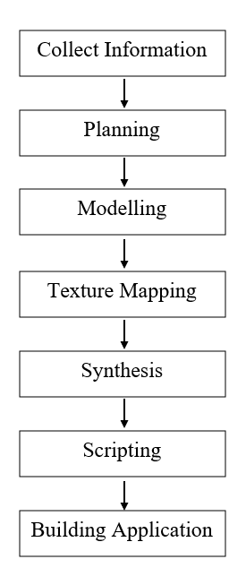
2.1 Design(Flow Of Modules)

Slide 14
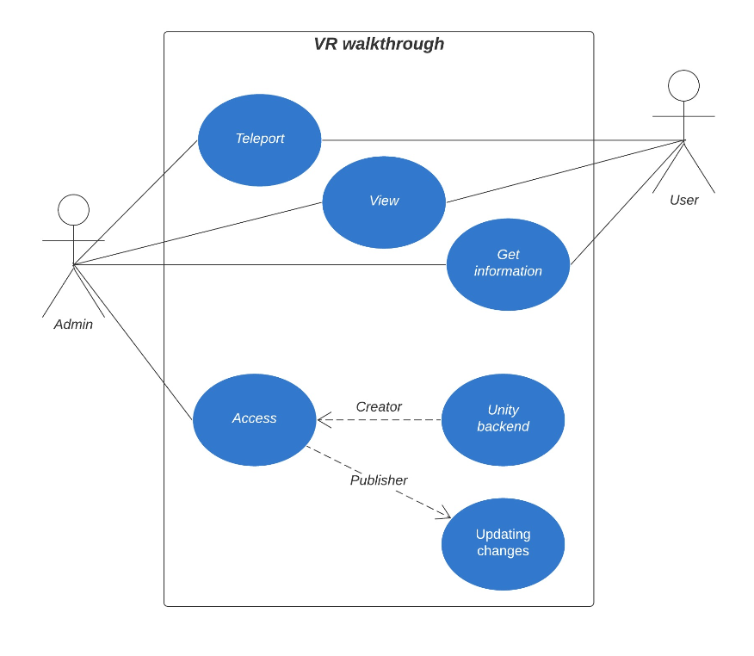
2.2 Use Case Diagram

Slide 15
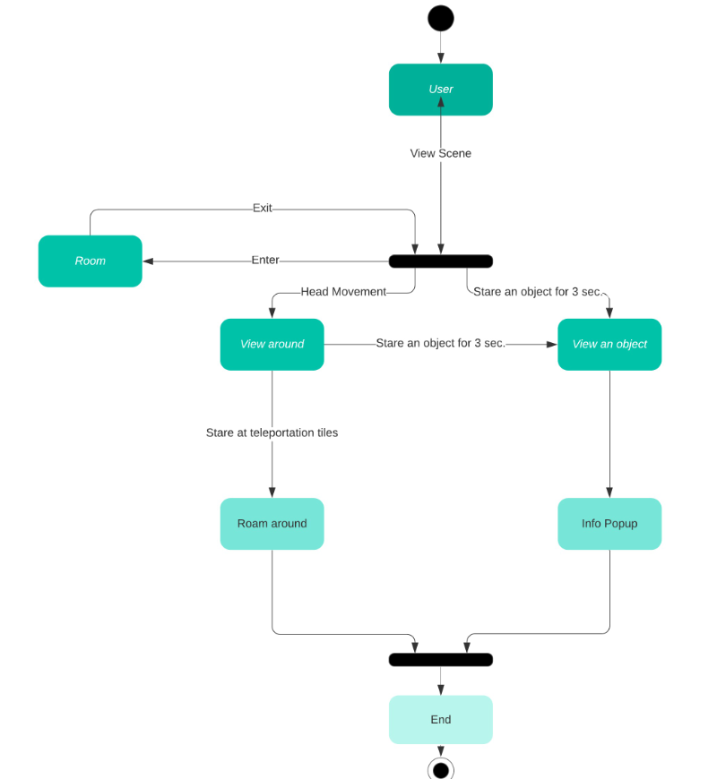
2.3 Activity diagram

Slide 16
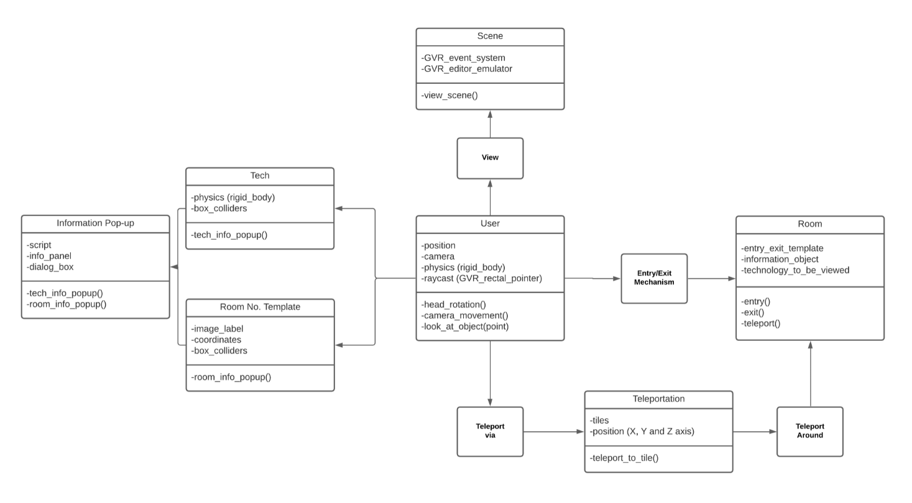
2.4 Class Diagram

Slide 17
3. Implementation

Slide 18
Head Movement.
Teleporting.
Specification of technology.
Information of Room.
Entry Exit Mechanism.
VR Gaze.

Slide 19
4. Testing

Slide 20
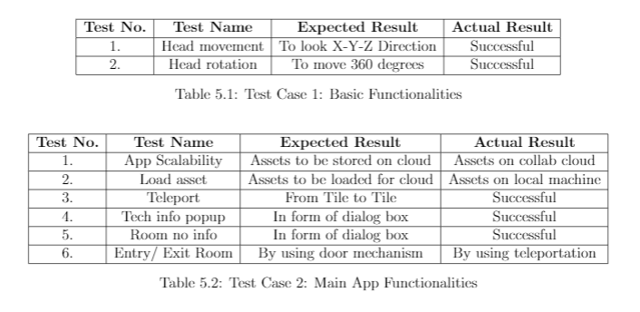

Slide 21
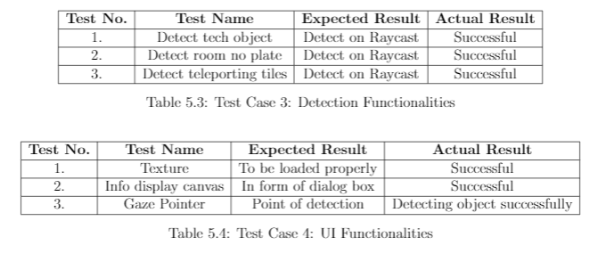

Slide 22
5. Result

Slide 23
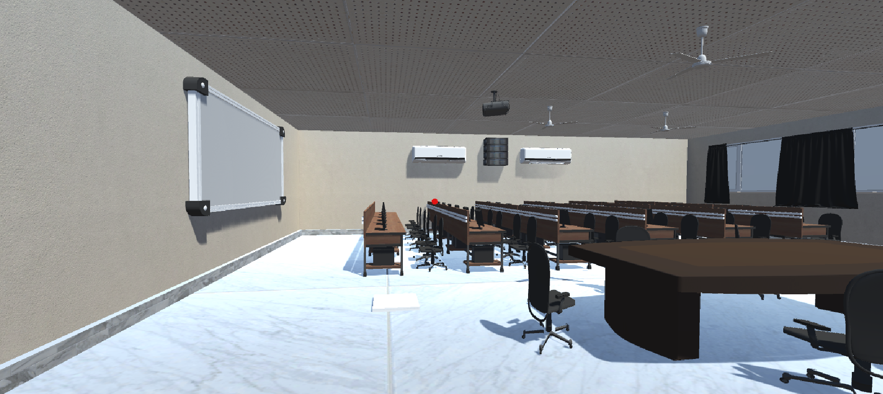
Scene of room 317

Slide 24
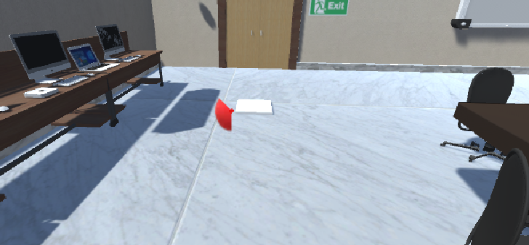
Implemented the teleporting tiles to teleport around the scene to provide a real life walk-through.

Slide 25
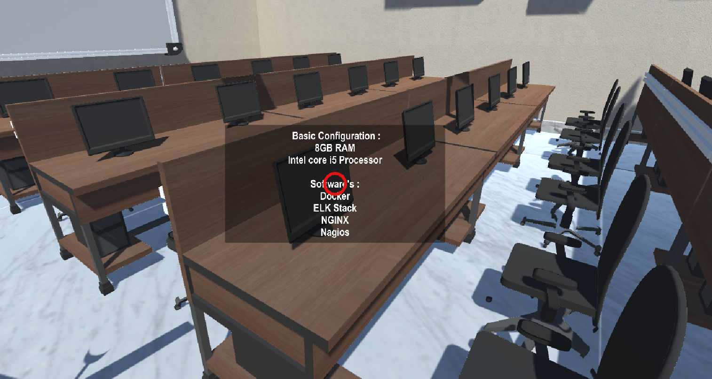
Implemented the information panel popping up on seeing on a specific object in a scene.

Slide 26
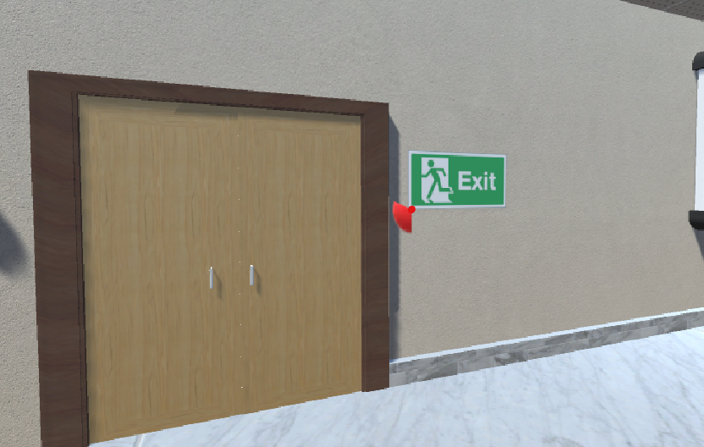
Implemented the entry and exit mechanism to enter and exit a room in scene.

Slide 27
6. Conclusion and Future Scope

Slide 28
Conclusion
By just sitting at one place in reality the user can have experience of virtual roaming through this VR application. This application has provided interactive walk-through through various interaction mechanisms which include teleporting technique for virtual roaming other than controllers to avoid motion sickness, displaying information on pointing to a particular object, entry and exit mechanism to enter and exit a particular room. Also learned modeling technologies like Blender and unity 3d and about various prefabs and scripts of Google VR plugins. Through this application, users can get information about the facilities provided by college and experience college campus as they are visiting it in real life.

Slide 29
Future Scope
In addition to this, we can also add more features to our application like security in terms of authentication and we can also add an animation of tour guide which will guide us in our whole tour. An artificial intelligence system could also be implemented so if the user has some questions regarding college, it could be answered by this system.

Slide 30
References
Ziguang Sun, Qin Wang and Zengfang Zhang,” Interactive walk-through of the virtual campus based on VRML,” Computer-Aided Industrial Design and Conceptual Design, 2008. CAID/CD 2008. 9th International Conference on, Kunming, 2008, pp. 456-458.
J. Jie, K. Yang and S. Haihui,” Study on the Virtual Natural Landscape Walkthrough by Using Unity 3D,” Computational and Information Sciences (ICCIS), 2013 Fifth International Conference on, Shiyang, 2013, pp. 1-4.
Xue-qin Chang, Dao-hua ZHANG and Xin-xin JIN. Application of Virtual Reality Technology in Distance Learning. International Journal of Emerging Technologies in Learning (iJET), [S.l.], v. 11, n. 11, p. pp. 76-79, Nov. 2016. ISSN 1863-0383.
Gilson Giraldi, R. S. (n.d.), “Introduction to virtual reality https://doi.org/10.1109/ VR.2003.119117.

Slide 31
Martin-Gutierrez, J., Mora, C. E., Anorbe-Diaz, B., and GonzalezMarrero, A. (2017),” Virtual technologies trends in education”, Eurasia Journal of Mathematics, Science and Technology Education, 13(2), 469–486.https://doi.org/10.12973/ eurasia.2017.00626 ISSN No 1305- 8223.

Slide 32
Paper Publication
We have submitted our paper in three conferences that is Springer ICTIS 2021, IEEE ICSCCC 2021, and Springer ICACDS 2021.

Slide 33
Thank You

